Slide 2
National Instruments Summer Engineering Internship
National Instruments offers Engineering and Physics students the opportunity to see what it is like to work for a multinational engineering company first hand.
Our three months placement opportunity within Applications Engineering, gives you the chance to be a full member of the team from day one. You will have an initial one month training programme in July where you will get to grips with NI technology and approaches; after then it is real hands on projects and real customer contact. Whilst with us you will go through technical and professional skills training which will test your current technical knowledge whilst also stretching your training to the next level.
If you can turn it on, connect it, drive it or launch it, chances are NI technology helped make it happen…… and we want to help you launch your career in engineering
Ongoing support and development from day one
Extensive training to quickly get you up to speed
Plenty of development opportunities in technical, business and interpersonal skills
Support and mentoring
Three unforgettable summer months in Budapest
A desire to learn technical knowledge, as well as business and interpersonal skills
Enthusiasm for working with customers alongside an entrepreneurial attitude
Excited about our technology and solving real world problems
On track for a strong result within Engineering, Computer Science and Physics disciplines
Interested?
For more information about our internship programme or to apply, visit:
http://hungary.ni.com/careers/internship

Slide 3
National Instruments Summer Engineering Internship
1 MONTH
2 MONTHS
Join us for three unforgettable months
of summer 2018 in Budapest
Notes:
1 month –
extensive trainings
2 months –
International communication – Meeting new people, cultures etc…
Tech suport duties
Projects – POCs for customers or just some for personal skills development
Get to know our customers = understanding the market, creating connectons & networking
Factory visit
And many others

Slide 4
National Instruments Summer Engineering Internship
1 MONTH
2 MONTHS
Technical Training
NI LabVIEW
NI Data Acquisition
Real-Time OS applications
FPGA programming
Product Speciality Groups
Notes:
1 month –
extensive trainings
2 months –
International communication – Meeting new people, cultures etc…
Tech suport duties
Projects – POCs for customers or just some for personal skills development
Get to know our customers = understanding the market, creating connectons & networking
Factory visit
And many others

Slide 5
National Instruments Summer Engineering Internship
1 MONTH
2 MONTHS
Applications Engineer Intern
Work on technical, business-impacting projects
Provide technical support to NI customers
Get in touch with cutting edge technologies
Be part of Applications Engineering Team
Get to know NI better
Notes:
1 month –
extensive trainings
2 months –
International communication – Meeting new people, cultures etc…
Tech suport duties
Projects – POCs for customers or just some for personal skills development
Get to know our customers = understanding the market, creating connectons & networking
Factory visit
And many others

Slide 6
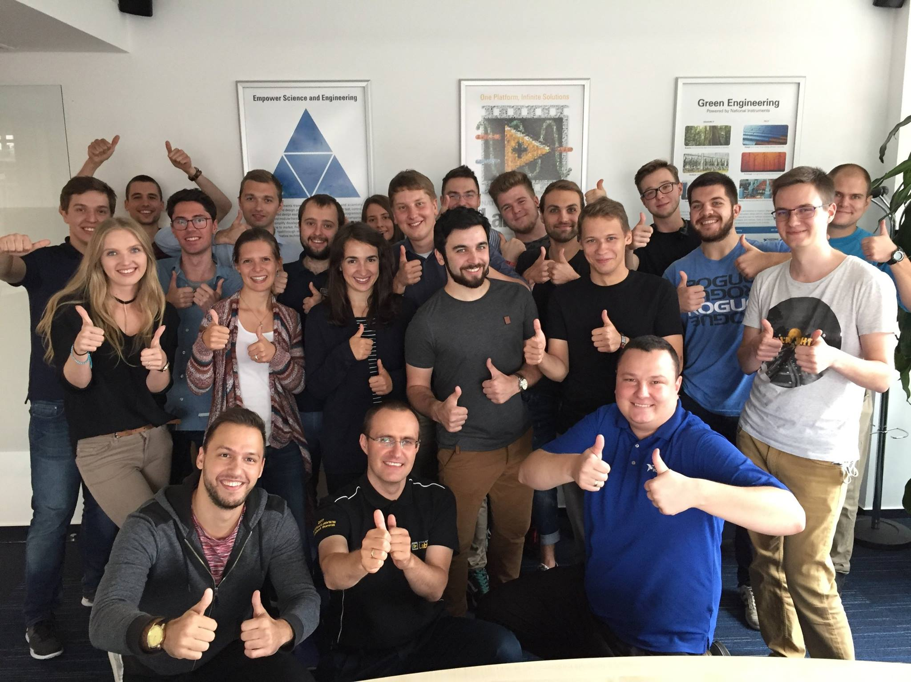
Employee Testimonials hungary.ni.com/careers/testimonials

